Slide 1
Transforming Healthcare Through
Nursing Innovation
Intellectual Property Protection Categories
Dr. Rhonda Schoville, PhD, MSBA, RN
April 8, 2024

Slide 2
Your Role as an Executive Nurse Leader
Evolve in
To help Nurses evolve in their roles and giving the outlets to grow by:
Strategic vision and direction of the organization; resources; advocacy; creating an environment of experimentation & use of novel approaches; dedicate time for innovators
Use education to empower nurses to creatively problem solve
Process
Human-centered design-understand the end users; ideating solutions; prototyping; testing
Discover
Knowledge

Slide 3
Nursing Innovation
Nursing innovation as an intentional nursing-driven process grounded in the fields of nursing science, implementation, and practice for creating a novel, often practical, solution or improved way of doing things inspired by a problem or unmet need identified for a specific healthcare population (e.g., patients, families, community) or healthcare organization (e.g., teams, management/leadership, academia), resulting in purposeful outcomes with value and impact
©2024 R. Schoville, A. Fitzsimons, B. Williams,
C. Anderson, K. Clements

Slide 4
Notes:
Collaboration of the health system

Slide 5
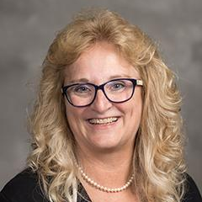
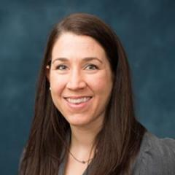
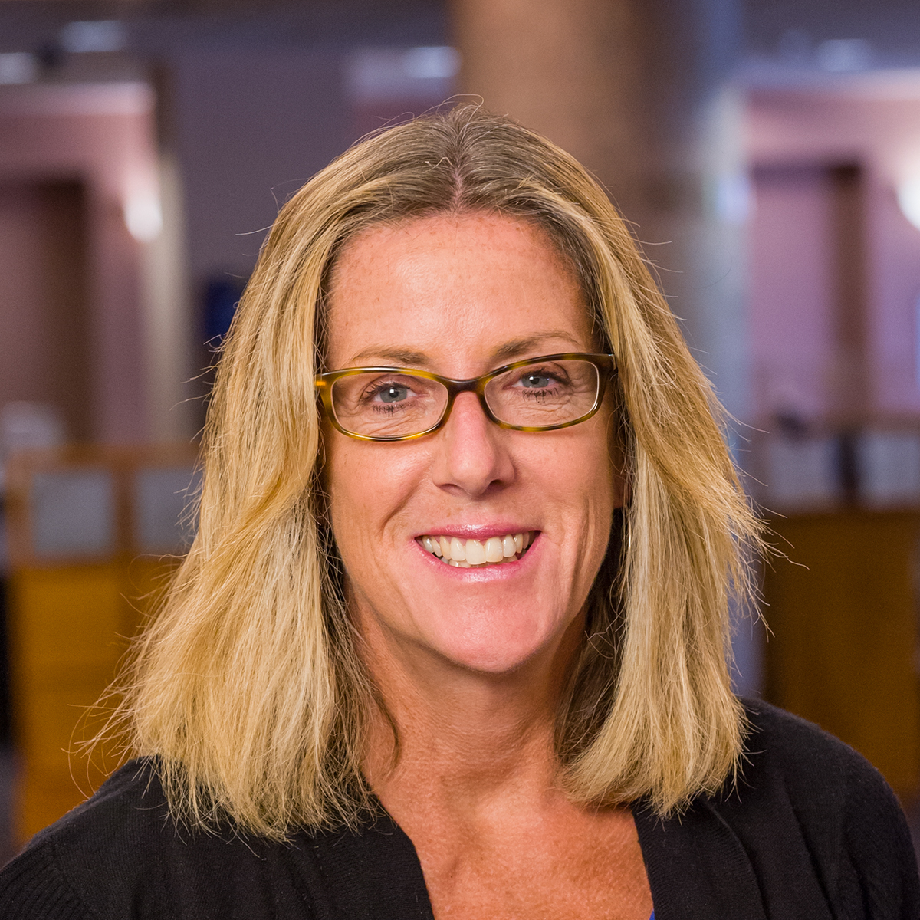
Introducing the Healthcare Innovation Impact Program (HiiP) Team
Rhonda Schoville, PhD, MSBA, RN – Director
Michele Munro-Kramer, PhD, RN – Faculty Lead for Student Engagement/Student Innovation Ambassadors
Ann Fitzsimons, BS, MBA - Innovation Portfolio Manager & Engagement Specialist

Slide 6
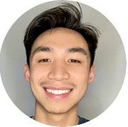
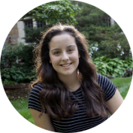
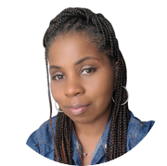
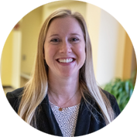
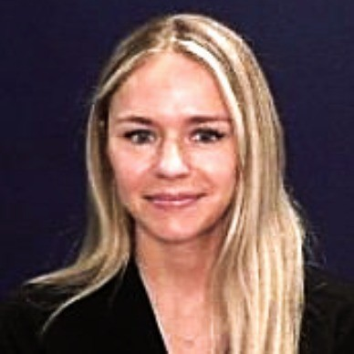
UMSN HiiP Student Innovation Ambassadors
UMSN HiiP Student Innovation Ambassadors:
Work to promote innovation among our nursing students
Provide feedback on what nursing students need/desire when it comes to innovation at UMSN
Plan, organize, design, and execute our student-centric activities like a Hackathon, innovation speakers for nursing students, record the Student Views recordings of HiiP’s Inspire, Innovate and Impact Podcasts series, and more
Ethan-Will Tolentino, U-M School of Nursing, MSN Student
Hannah Slawson
U-M School of Nursing, BSN Student
Linnea Brunvand
U-M School of Nursing, BSN Student
Virginia Mundy, BSN, RN, U-M School of Nursing, MSN Student
Greyza Masterson
U-M School of Nursing, BSN Student
Becky Williams, BSN, BS, RN
U-M School of Nursing Ph.D Student
Sara Eidt, BSN, RN
U-M School of Nursing,
MSN Student

Slide 7
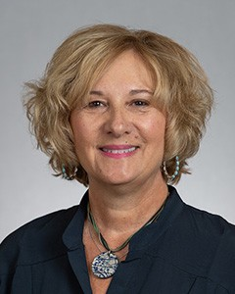
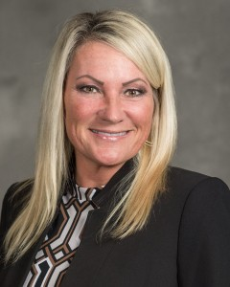
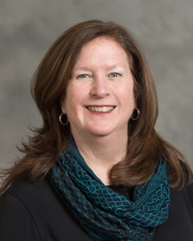
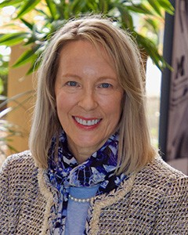
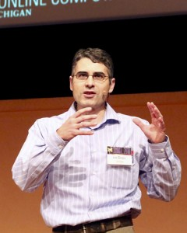
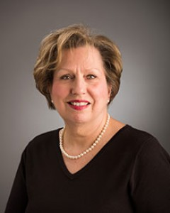
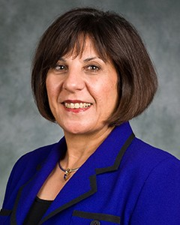
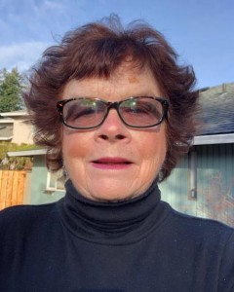
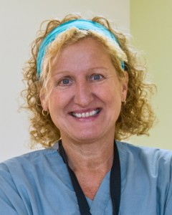
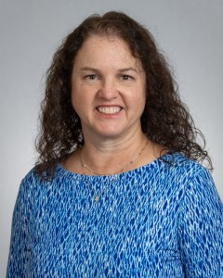
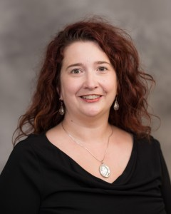
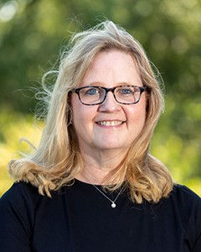
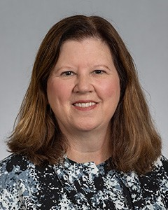
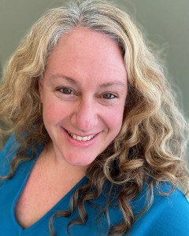
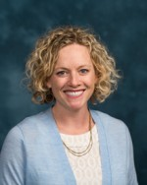
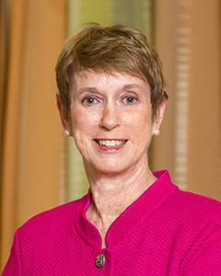
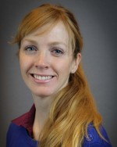
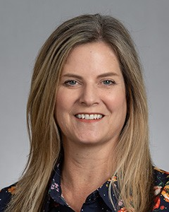
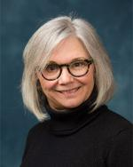
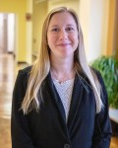
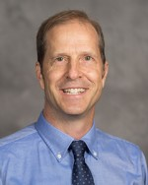
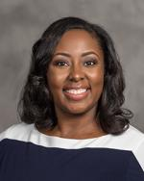
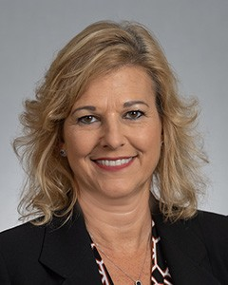
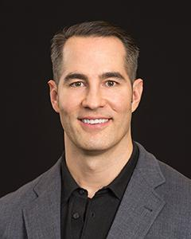
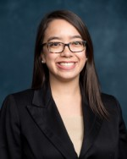
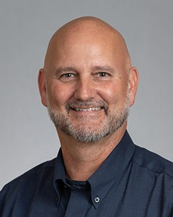
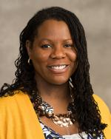
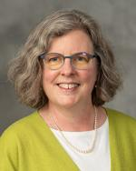
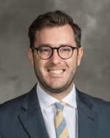
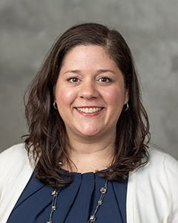
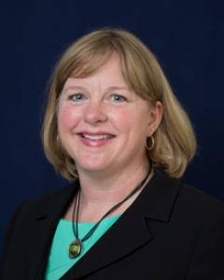
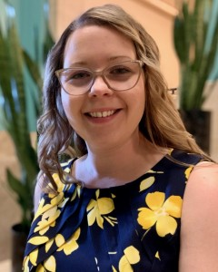
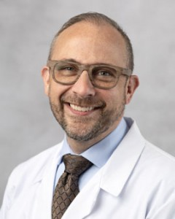
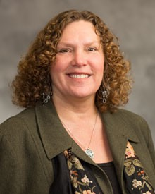
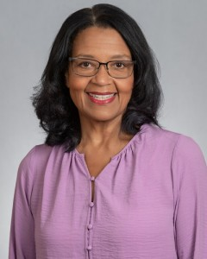
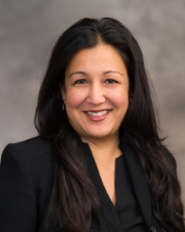
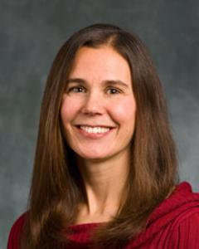
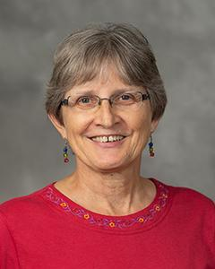
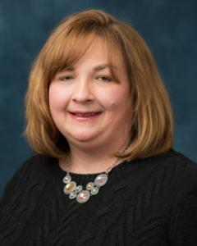
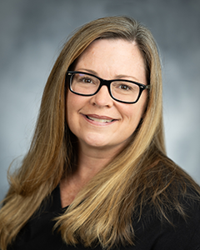
UMSN Nursing Innovation is Having Impact!
Environmental Sustainability
Model to Predict Healthcare Utilization After Disasters
Trauma-Informed Care
Patient Education on Trach Care
Naloxone Training for Law Enforcement Officers & Community Laypersons
Diabetes Prevention
Blood Pressure Self-Management among African American Women
Mental Health Screening of College Students
…and so many more!
Notes:
Our Nurse Innovators are working on a wide and diverse set of innovations across so many different areas of healthcare from…(read some of the topical areas). We are honored to work (and are in awe of) these dedicated nursing professionals as they work to turn their passion into purpose for the good of all.
New Moms Coping with Trauma
Caregiver Stress Reduction
Mental Health Screening of College Students
Nurse Manager EBP Competencies
Telehealth Assessment Provider Training
Enhanced Simulation Training & Skills Practice Using New Technology
Sexual Assault Victimization…
Some metrics on our progress:
School has filed 38 Invention Disclosure Reports with Innovation Partnerships; several more in progress
14 or more program/intervention/services launched to the marketplace
Some of these were licenses for a fee and some were Creative Commons open source licenses
These innovations are being used!
Nurse Manager EBP Competency Scale Toolkit: 6 licenses issued (Clayton Shuman, Maria Titler, Rob Ploutz-Snyder)
Trauma Informed Care (TIC) Grade Scale: 40 licenses issued (Cascaid Group—Julia Sent, Nicole Boucher, Cindy Darling-Fisher)
Survivor Mom’s Companion the flagship program of Growing Forward Together non-profit (Julia Seng)

Slide 8
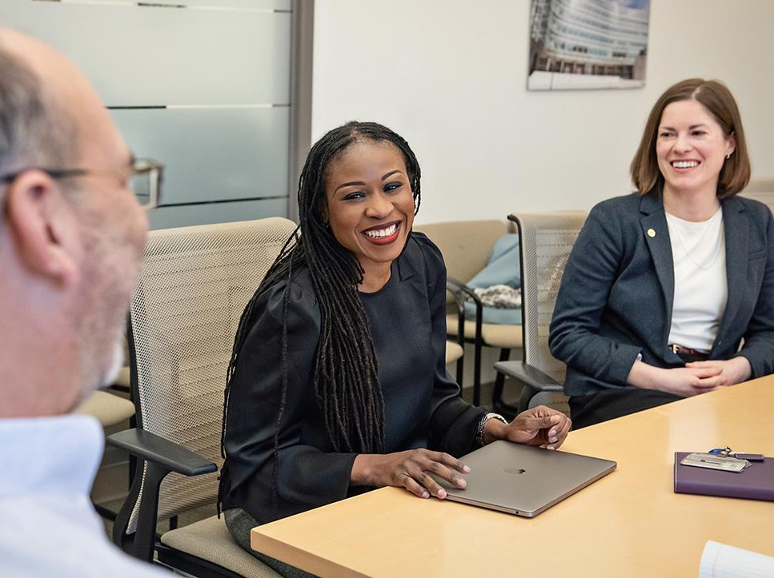
Innovation Partnerships was designed with Faculty service in mind:
Innovation Partnerships is a connector for faculty desiring to amplify the impact of their research through partnering with industry:
Corporate sponsored research
Licensing & commercialization
Startup company formation
- internal - preliminary - advisory - hr
Notes:
Other schools might call this tech transfer or in the office research office
Nursing Innovators work closely with this department for a variety of support
Translational Research Funding
Business Mentorship
Venture Capital Investment
Connections to Entrepreneurial Talent
Incubator Space

Slide 9
Faculty & Student Innovation Resource Organizations
(((© University of Michigan School of Nursing, 2023
Notes:
(Faculty & Students)
Center for Academic Innovation
Center for Entrepreneurship (CFE)
Center for Health & Patient Safety (CHEPS)
Desai Accelerator
Fast Forward Medical Innovation (FFMI)
Healthcare Innovation Impact Program (HiiP)
NSF’s Innovation Corps (I-
Corps™)
Multidisciplinary Design Program (UM Engineering)
Ross Business Impact
Zell Lurie Institute

Slide 10
Innovator Pathway
Idea Generation | Idea Development & Refinement | Business Planning & Execution | Launch/Promote& Monitor
Identify a problem / need / opportunity. Brainstorm creative solutions. Outline the core idea and its key basic elements. | Conduct customer discovery. Conduct competitive benchmarking (if applicable). Develop detailed concept(s) for idea. Test feasibility. Review and refine concept(s). Develop prototype of how idea will be represented to the target. | Develop business case. Identify investment funds, if needed, to underwrite development / launch. Produce program / process / product. Produce any needed marketing materials. | Launch the innovation to intended target. Generate awareness of and create interest in the innovation. Monitor launch efforts and adjust as needed.
(((© University of Michigan School of Nursing, 2024

Slide 11
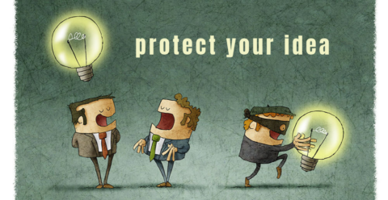
What & Why is Intellectual Property Protection Important

Slide 12
What is Intellectual Property Protection
IP is protected in law by, for example, patents, copyright and trademarks, which enable people to earn recognition or financial benefit from what they invent or create. By striking the right balance between the interests of innovators and the wider public interest, the IP system aims to foster an environment in which creativity and innovation can flourish.
Intellectual property (IP) refers to creations of the mind, such as inventions; literary and artistic works; designs; and symbols, names and images used in commerce.
What is Intellectual Property? (World Intellectual Property Organization, 2024)
Notes:
IP law is very complicated, and lawyers taken different bars when wanting to be a patent and IP attorney.
There are different laws for the different types of IP protection, different national laws between countries and regions around the world including international law.
IP rights have been recognized since the 15th century (Venice Greece). More recent recognized by the
Convention for the Protection of Industrial Property (1883); Berne Convention for the Protection of Literacy and Artistic Works (1886)
Today there are more than 25 international treaties on IP administered by SIPO and by article 27 of the Universal Declaration of Human Rights.

Slide 13
Patent Protection
A patent is an exclusive right granted for an invention. A patent provides the patent owner with the right to decide how - or whether - the invention can be used by others. In exchange for this right, the patent owner makes technical information about the invention publicly available in the published patent document.
Notes:
Patent owner can stop anyone from using, making, or selling their innovation.
Patents last for 20 years
To qualify – some practical use and must offer something new which is not part of the existing body of knowledge in the relevant technical field- prior art
The invention must also involve an inventive step-something non-obvious that could not just have been deduced by someone with average knowledge of the technical field
Examples of non-patentable-
Scientific theories, mathematical methods, plant or animal varieties, discoveries of natural substances, commercial methos and methods of medical treatment (as opposed to medical products)
Patent applications include-describe the invention clearly and in sufficient detail including drawings, plans or diagrams this information to help determine the extent of protection to be granted—the patent office will determine if it qualifies for protection
Owners can exclusively use innovation commercially, license the intervention to others, or sell the patent outright
If someone uses it without permission- the person can be sued for infringement which may include stopping usage and awards of financial compensation
Patents can be challenged in court i.e. apple watch
Laws can vary between countries
Example---don’t use your patents to raise money or place limits on it
Not to publish early---that inhibits them to get a patent bc it is already out there

Slide 14
Copy Right Protection
Copyright is a legal term used to describe the rights that creators have over their literary and artistic works (creative expression of ideas). Works covered by copyright range from books, music, paintings, sculpture and films, to computer programs, databases, advertisements, maps and technical drawings.
Notes:
Time limit-All rights reserved, open sources (creative commons-different conditions)
Copyright owner can stop anyone from copying or using a work without permission i.e. translating it, reproducing it, performing it or broadcasting it. Civil and criminal penalties.
Copy right laws do not cover the actual ideas, procedures, methos of operation, or mathematical concepts
Copy right is limited in time and then becomes public domain (throughout the life of the creator and 70 years after the death of the creator)
Does not cover singers, actors, broadcasting organizations=they are covered under neighboring rights (only covered for 50 years)
New laws are being considered-3D printing, digital technologies
Types – registered and nonregistered. Registered gives more legal protection and costs $45-125.00 and takes 1-3 months

Slide 15
Trademarks
A trademark is a sign capable of distinguishing the goods or services of one enterprise from those of other enterprises. Trademarks date back to ancient times when artisans used to put their signature or "mark" on their products. Protection from counterfeit organizations and ensures consumers that the product is genuine.
Notes:
To protect the trademark, it should be registered with a list of goods and services to which it would apply. The trademark is only good for 10 years but can be renewed indefinitely for a cost. The trademark can be sold or licensed
If there is infringements of the trademark the organization using it can prosecute.
Trademarks are territorial but now groups have been established where there are regional and international protection
I.e. Tequila liquor from Mexico

Slide 16
Trade Secrets
Trade secrets are IP rights on confidential information which may be sold or licensed. The unauthorized acquisition, use or disclosure of such secret information in a manner contrary to honest commercial practices by others is regarded as an unfair practice and a violation of the trade secret protection.
Notes:
Examples:
Formulas, recipes, and ingredients, such as the secret formula for Coca-Cola
Methods, processes, and techniques, such as the New York Times Bestseller list
Engineering information, such as techniques for converting raw materials
Business and financial information, such as budgets, costs, and pricing
Computer programs and algorithms, such as software code and scripts
Masimo Corp. et al. v. Apple Inc. (United States District Court, Southern District of California, Case No. 8:20-cv-00048) is another recent example of trade secret litigation in the healthcare industry. There, a medical device maker, Masimo Corp., sued Apple alleging that Apple poached key employees and misappropriated trade secrets for use in the Apple Watches. Masimo contends that Apple engaged in the wrongful conduct after Apple approached it to discuss collaborating on technology which can track heart rate, blood oxygen levels and other health indicators by measuring how light passes through body tissue. Masimo and Apple ultimately did not go forward with the collaboration. This case presents a common circumstance giving rise to a trade secret misappropriation claim – a potential collaboration or other relationship that does not go forward. A party to such discussions where confidential information is disclosed to evaluate the potential relationship should take care to protect its confidential information from misuse and to limit the other party’s ability to assert unwarranted misappropriation claims if the discussions fall apart.

Slide 17
Open Access-Open Innovation
Open access usually means distributing research or educational materials online at no cost to the user. Owners of these materials typically retain the copyright and control the distribution of the works.
Creative Commons is a nonprofit that licenses a tremendous amount of creative, usually copyrighted, works. Central to its mission is assisting people and organizations in “overcoming legal obstacles to sharing knowledge and creativity.
Notes:
Open source often refers to software available free of charge, but also describes a larger conceptual movement. The Open Source Initiative promotes the sharing of source code, and provides guidance on its distribution. Its principles include requiring that a license
“So why would a creator choose to grant a free license to his or her creative works? For one, creativity often generates more creativity, and those who choose to present their works for free may do so with the thought that it may encourage new ideas, products and solutions to larger societal challenges. In addition, allowing free access levels the playing field a bit so that entrepreneurs and individuals can better compete with big corporations who have greater resources (What is Open Access? Understanding Traditional IP Rights - Michelson IP).
Open Innovation: Research, Practices, and Policies - Marcel Bogers, Henry Chesbrough, Carlos Moedas, 2018 (sagepub.com)
Use of a third party work…..

Slide 18
Open Source-Content
creativecommons.org/choose/ - a tool to choose which type to use
Notes:
There are six different license types, listed from most to least permissive

Slide 19
Organizational Policies
Ownership
Invention Reporting
Commercialization
Revenue Sharing with Inventors
Revenue Distribution with the University
Granting Rights back to the Inventor
Appeal Process
Conflict of Interest & Commitment
Employment contracts
Policy defines the ownership, distribution, and commercialization of rights associated with Intellectual Property developed at or received by the University of Michigan, and describes the general obligations associated with the technology licensing process. Substantive changes to this Policy, as long as consistent with Section 3.10 of the Bylaws of the Board of Regents, may be modified from time to time by the Vice President for Research in consultation with the President, with notice to the Regents.
University of Michigan Technology Transfer Policy | Standard Practice Guides - University of Michigan (umich.edu)
Notes:
Who holds copy right (601.28 Scholarly work)
This policy promotes the University of Michigan’s scholarly, academic, and service missions by establishing a framework for who holds copyright at the University. Because the University is committed to academic freedom, it strives—despite the legal default—to place copyright with the creators of scholarly, academic, and artistic works. Moreover, this policy encourages and does not limit the rights and abilities of people to make “fair uses” or other lawful uses of copyrighted works.
Conflicts of Interest and Conflicts of Commitment
Given that the University of Michigan allows and encourages outside activities and relationships that enhance the mission of the University, potential conflicts of interest and commitment are inevitable. Outside activities should not, however, interfere with an individual’s University obligations. Faculty and staff must not use their official University positions or influence to further gain or advancement for themselves, parents, siblings, spouse or partner, children, dependent relatives, or other personal associates, at the expense of the University.
Technology Transfer
Who is a contributor---not a vendor
Employment contracts

Slide 21
Investors
Many ways to fund your idea—the innovator must weigh what the investor wants to what they will bring to the table
Research Dollars-National Institute of Health, Department of Defense, National Science Foundation
Angel Funding
Venture Capital
Standard Loans (small business loans)
Notes:
Research dollars – NIH, DOD, National Science Foundation,
Angel funding-wealthy individuals who fund start us at a cost (convertible debt or ownership equity)
Venture Capitalists- pool of investors who fund the start up (convertible debt or ownership equity)
Standard Loans (Small business loans-Spark)
Many ways to fund your idea---each one of these different groups will take something and be careful and weigh against what they want and what they give/bring to the table
Donors
Professional Organizations

Slide 22
Nurse Innovator Companies

Slide 23
Nurse Innovator: Clayton Shuman, Ph.D., MSN, RN
Nurse Leader EBP Competency Scale & ArtSpective
Dr. Clayton J. Shuman, PhD, MSN, RN (claytonshuman.com)
Notes:
Officially is a start up company-400 users
ArtSpective is an evidence-based training program meticulously crafted to aid individuals in recognizing and rectifying implicit biases through the ingenious use of art-based methods.
Started with his research findings that mothers with drug problems them and their babies were treated differently in the Neonatal ICU

Slide 24
Nurse Innovator: Michelle Munro-Kramer Ph.D., CNM, FNP-BC
Human Trafficking (Modern Slavery) Website & Education Module
The Dynamics of Interpersonal Coercion among College Students Tool
Notes:
Human Trafficking Website & Education Module and The Dynamics of Interpersonal Coercion among College Students Tool
There is no one profile for human traffickers or victims. Traffickers can be strangers who exploit or manipulate the victim, or they can be friends or family members that take advantage of a vulnerability. Traffickers might work alone. For instance, a couple may traffic a nanny or housekeeper for their own personal use. Traffickers can also be part of a network who are engaged in sexual or labor trafficking and other criminal activities.
Victims can include vulnerable individuals such as those with dysfunctional home lives (for example, a history of child abuse or neglect, homeless or runaway youth, being in foster care or in the criminal justice system, family conflict). Some neighborhood level factors include poor schools or opportunities for education, unsafe neighborhoods, lack of opportunity for work, gang involvement. Individuals who identify as LGBTQ are at higher risk than other groups for human trafficking. A lack of knowledge about human trafficking also puts individuals at risk.
As a disclaimer, use the word “victim” to describe these individuals because that is how they are described in the law. Other words that might be used to describe this population are “survivors” or “trafficking victims.”
68% of US-based trafficking survivors came in contact with a healthcare provider (Chisolm-Straker et al., 2019)
88% of domestic sex trafficking survivors came in contact with a healthcare provider (Lederer & Wetzel, 2014)

Slide 25
Notes:
The website includes content on:
A general about human trafficking section to combat myths and misperceptions
Education – including a free continuing education module
Policies and procedures – which includes interactive and fillable sample screening policies and response protocols that could be used in different health facilities (e.g., health departments, hospitals, outpatient clinics)
Support survivors section with national resources
Research – a brief overview of the UM Human Trafficking Collaborative research
State-specific resources – a section that provides an overview of state requirements for healthcare providers/systems related to human trafficking

Slide 26
Timeline
2015: Interdisciplinary human trafficking partnership begins in Ethiopia
2016-2017: 4 UMSN students build human trafficking database with UM Law School data to understand health outcomes
Fall 2017: Co-Developed Law School Course to create standardized healthcare policies for human trafficking screening & response
2019: State of Michigan Study to understand screening and response at FQHCs, hospitals, and health departments
February 2021: Launched continuing education module in partnership with Region V Public Health Training Center
Spring 2017: State of Michigan develops human trafficking requirements
September 2021: Launched UM Human Trafficking Website
April 2023: Human trafficking podcast episodes launched with Michigan Medicine
Notes:
2015: Interdisciplinary partnership begins in Ethiopia
2016-2017: 4 UMSN students (2 grad and 2 undergrad) build a database from the University of Michigan Law School’s Human Trafficking Clinic to understand the healthcare, service, and legal needs of human trafficking survivors
2017: The State of Michigan recognizes the alarming levels of human trafficking and the potential role of health providers. Requires that all healthcare providers (nurses, physicians, social workers, massage therapists, dentists, etc.) receive one hour of training related to human trafficking before their next license renewal
Fall 2017: Along with my colleague Bridgette Carr I co-developed a law school problem-solving course on addressing human trafficking within the health care system
2019: State of Michigan study to understand human trafficking screening and response at health facilities in Michigan
February 2021: Launched continuing education module in partnership with Region V Public Health Training Center
September 2021: Launched UM Human Trafficking Website
April 2023: Partnered with Michigan Medicine to record two national podcasts on human trafficking

Slide 27
Impact
Feb. 2021
Over 30,000 continuing education learners since February 2021
Sep. 2021
113,000 Website Users from 10 countries since September 2021

Slide 28
Nurse Innovator: Julia Seng, Ph.D., CNM, FAAN
Survivor Mom’s
Companion Program
Notes:
Officially a start up company

Slide 29
Growing Forward Together (GFT)
2013 Clinical and Field Trials UK - Blackpool
2017:
Survivor Mom’s Companion Released
9/2020 - 3/2021:
Partner Evaluation
2021:
501(c)3 Formation
Program Launch
INITIAL LICENSE
7/2016
GFT LICENSE
3/2021
7/2013: Invention
Disclosure
2016: Co-Developer Monash University IP and Copyright Assignment
1/2021:
Sidran Institute
Termination
Innovation Partnership Support
Notes:
6799 was disclosed in 2015.
Option executed in 2016.
License executed in 2018.

Slide 30
Your Role as an Executive Nurse Leader
Having a pro-innovation climate-be
open to new Ideas-don’t be nay sayers
Innovation is not necessarily technology
Connect the Dots for your staff-resources, committees, stakeholders (Biomed, IT, Technology experts)
Provide a safe place to innovate
Develop core competencies & policies
Recognize staff’s innovation work
Business Entrepreneurship - YouTube
Notes:
https://www.youtube.com/playlist?list=PL8dPuuaLjXtNamNKW5qlS-nKgA0on7Qze

Slide 31
Thank you to Dean Hurn!
Thank you, Dean Hurn, for your continued support!
Notes:
Patricia D. Hurn, Ph.D. RN, FAAN
Dean Hurn had the vision that nurses are the most trusted profession, and they should be innovating and at the innovation tables. We thank her for this vision and supporting the HiiP program.

Slide 32
In Closing
NURSE INNOVATORS-
IT’S TIME TO MAKE MAGIC HAPPEN AND TRANSFORM THE FACE OF HEALTHCARE!

Slide 33
References
Suntres, T. (2024). Creative Commons.
https://creativecommons.org/share-your-work/cclicenses/
Munro-Kramer, M. (2024). Human Trafficking Collaborative.
https://www.bing.com/ck/a?!&&p=4e6608462e207e5cJmltdHM9MTcwOTUxMDQwMCZpZ3VpZD0wMDljYWM1NS1lYTk2LTYzMzItM2EzOS1iODY2ZWI4NTYyZGYmaW5zaWQ9NTE5MQ&ptn=3&ver=2&hsh=3&fclid=009cac55-ea96-6332-3a39-b866eb8562df&psq=Human+Trafficking+(Modern+Slavery)+Website+%26+Education+Module%2c+michelle+munro-kramer&u=a1aHR0cHM6Ly9odW1hbnRyYWZmaWNraW5nLnVtaWNoLmVkdS9hYm91dC90ZWFtL21pY2hlbGxlLWwtbXVucm8ta3JhbWVyLw&ntb=1
Seng, J. (2024). Growing Forward Together.
https://www.growingforwardtogether.org/
Shuman, C. (2024). ArtSpective. https://www.claytonshuman.com/
University of Michigan Technology Transfer Policy | Standard Practice Guides - University of Michigan (umich.edu)
World Intellectual Property Organization (2024). What is Intellectual Property?

